Slide 1





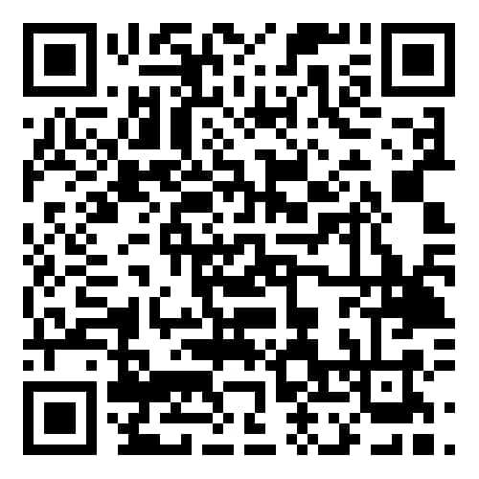

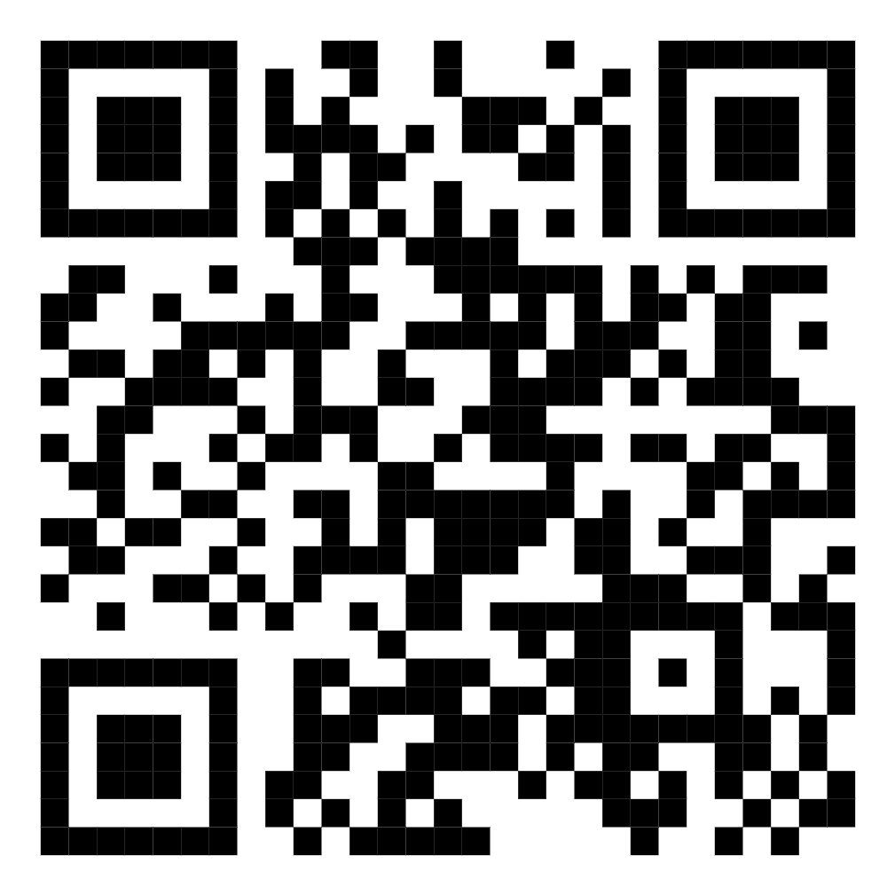


1st National Seminar on
Nature, Life, and Earth Sciences
(1st NSNLES’2025)
Bouira, Algeria, Dec 9 & 10, 2025
Title of Contribution must appear here (reduce font size to make title fit into this space)
Name First Author¹, Name Second Author², Name Third Author³
1. Institution of Author1, 2. Institution of Author2, 3. Institution of Author3
*Corresponding author : author-email@university
logo
Background
Results and Discussion
Objectives
Methods
References
1-
2-
3-
4-
5-
Conclusion
Akli Mohand Oulhadj-Bouira University, Faculty of Nature, Life and Earth Sciences (FSNVST)
9VHF+698, Rue du Mars 1962, Bouira
nsnles.2025@univ-bouira.dz
026731007

